Slide 1

Learning Intentions: Today we are continuing our learning about human nature.
Success Criteria: By the end of the lesson I will:
. Be clear about the difference between the two Yetzers.

Slide 2
Judaism
Beliefs
• beliefs about God
• nature of human beings: yetzer tov; yetzer harah; free will; suffering
• beliefs about Covenant
• judgement; the Messiah; the Messianic Age; Olam Ha’ba
Practices
• living according to the Commandments
• Rosh Hashanah; Yom Kippur
• worship: Shabbat; synagogue

Slide 3

Starter task:
On the post it note write down the 3 quotes we learnt yesterday about the nature of God!
Here’s a little bit of help
God is eternal:
God is the creator, and he is omnipotent:
God is benevolent:

Slide 4
God is eternal: “The Lord is the everlasting God.” Isaiah
God is the creator, and he is omnipotent: “In the beginning, God created the heavens and the earth.” Genesis 1:1
God is benevolent: “God is merciful and gracious, slow to anger, and abounding in steadfast love.” Exodus

Slide 5
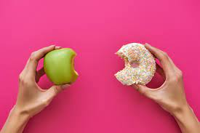
Back to……
Yetzer Tov and Yetzer Harah

Slide 6

This dual inclination is called the Yetzer Tov and Yetzer Harah
The word ‘Yetzer’ means impulse.
Yetzer Tov: good impulse.
Yetzer Harah: selfish/’evil’ impulse.

Slide 7
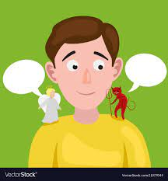
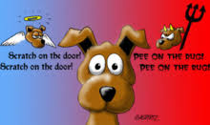
Yetzer Tov
The Yetzer Tov is a humans moral conscience.
It’s the idea of an inner voice or a gut feeling reminding Jews of God’s law.
Jews believe this inner voice is a reminder of
what God would want them to do and it should
dissuade them from doing something that goes
against God’s law.

Slide 8
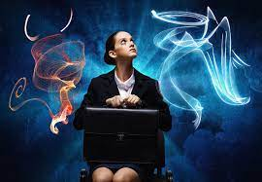
Yetzer Harah
The Yetzer Harah is more difficult to define.
It is not an inclination to go out and do harm, as in the way we understand the word ‘evil’, it is more of a selfish nature, the desire to satisfy personal needs with no regard for others or the consequences.
When the Yetzer Harah takes over suffering happens.
Like any other human impulse, the YH & YT need to be balanced. If this is done correctly, humanity will not suffer.

Slide 9
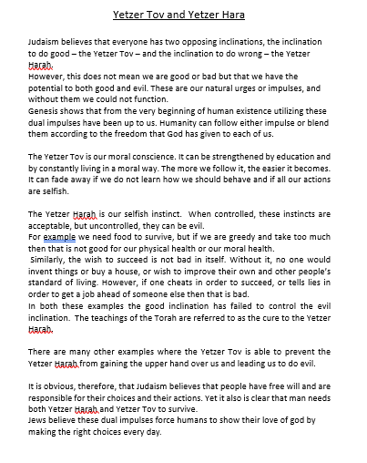

Read through the information sheet highlighting the key pieces of information.
Then stick this into your jotters.

Slide 10
Homework: On GC or skills jotter.
Questions on the Yetzer tov and Yetzer hara
Give a simple explanation for the terms yetzer tov and yetzer hara. (2)
In what ways can the yetzer hara be useful for humanity? (1)
In what ways can the yetzer hara damage humanity?(1)
Do you agree with this concept? Give two reasons for your answer.(2)
Due on Thursday (25.8.22)

